Slide 1
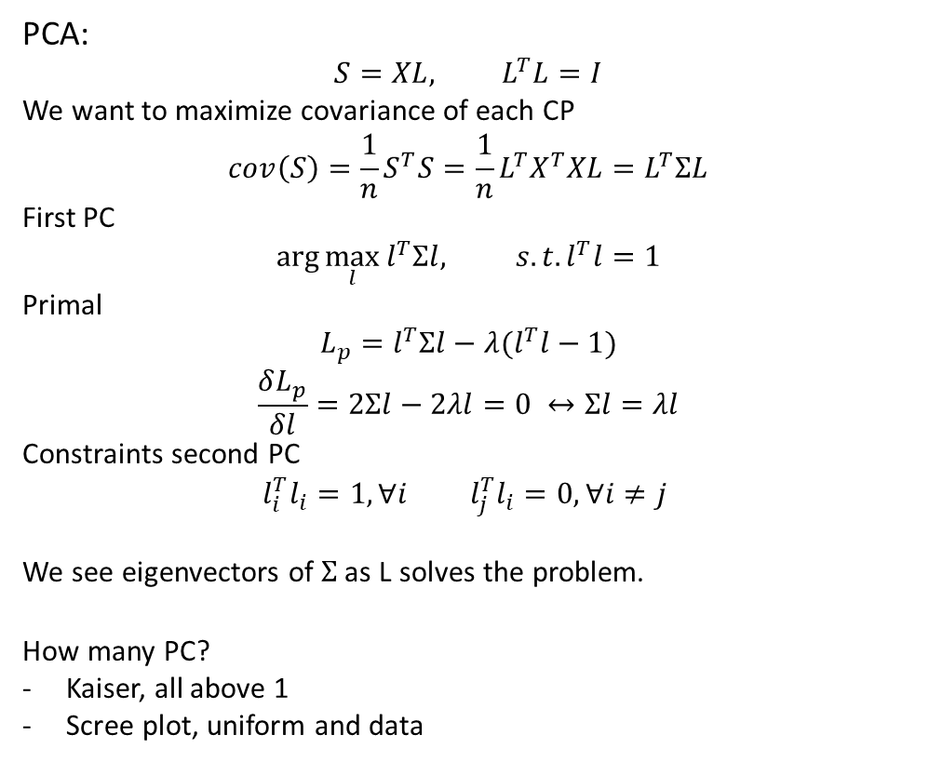
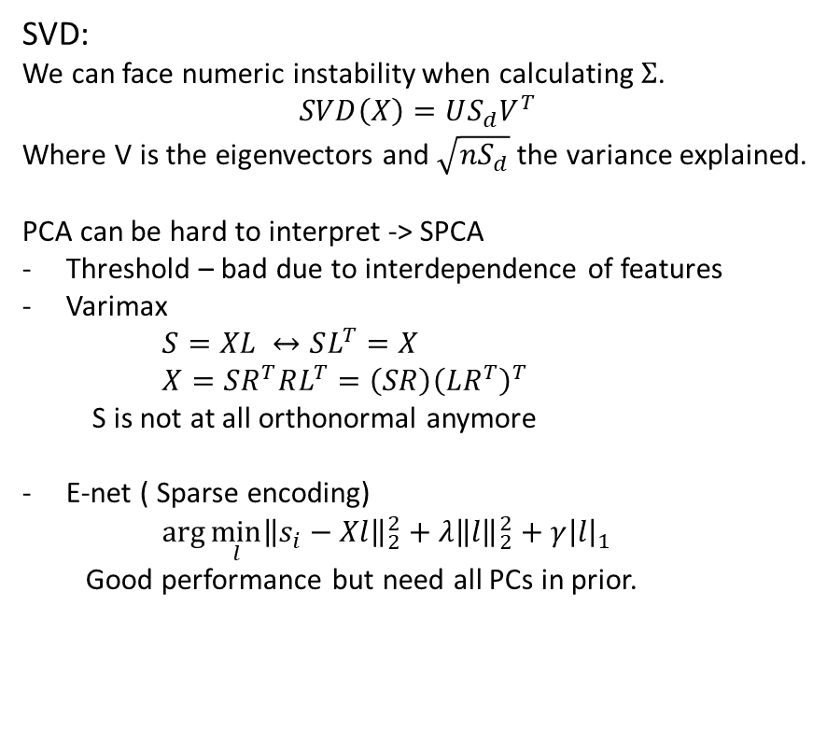
Lecture 8
PCA:
$$S=XL,{ L}^{T}L=I$$
We want to maximize covariance of each CP
$$cov\left(S\right)=\frac{1}{n}S^{T}S=\frac{1}{n}L^{T}X^{T}XL=L^{T}ΣL$$
First PC
$$\arg{\max_{l}{l^{T}Σl, s.t. l^{T}l=1}}$$
Primal
$$L_{p}=l^{T}Σl−λ(l^{T}l−1)$$
$$\frac{δL_{p}}{δl}=2Σl−2λl=0 ↔Σl=λl$$
Constraints second PC
$$l_{i}^{T}l_{i}=1, ∀i l_{j}^{T}l_{i}=0, ∀i≠j$$
We see eigenvectors of $Σ$ as L solves the problem.
How many PC?
Kaiser, all above 1
Scree plot, uniform and data
SVD:
We can face numeric instability when calculating $Σ$.
$$SVD\left(X\right)=US_{d}V^{T}$$
Where V is the eigenvectors and $\sqrt{nS_{d}}$ the variance explained.
PCA can be hard to interpret -> SPCA
Threshold – bad due to interdependence of features
Varimax
$S=XL ↔SL^{T}=X$ $X=SR^{T}RL^{T}=\left(SR\right){\left(LR^{T}\right)}^{T}$
S is not at all orthonormal anymore
E-net ( Sparse encoding)
$\arg{\min_{l}{{\left\|s_{i}−Xl\right\|}_{2}^{2}+λ{\left\|l\right\|}_{2}^{2}+{γ\left|l\right|}_{1}}}$
Good performance but need all PCs in prior.
Notes:
Gini er konventionen til opbyggelse og miss class er til prune

Slide 2
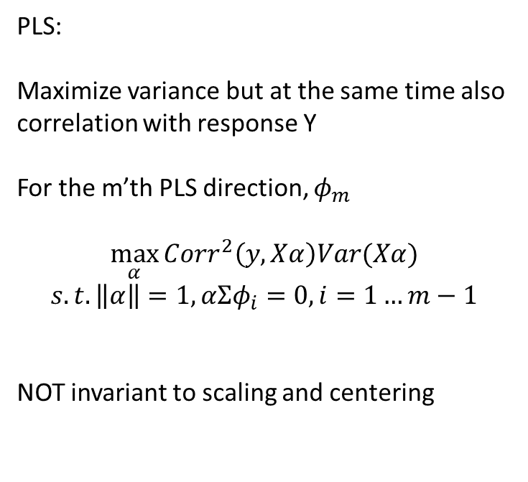
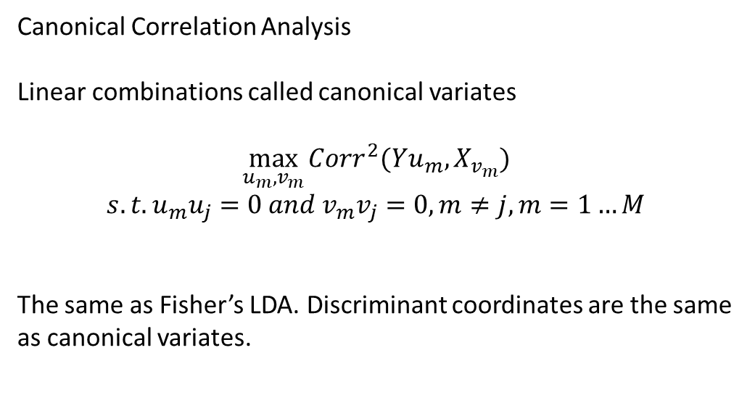
Lecture 8
PLS:
Maximize variance but at the same time also correlation with response Y
For the m’th PLS direction, $φ_{m}$
$$\max_{α}{Corr^{2}\left(y,Xα\right)Var(Xα})$$
$$s.t. \left\|α\right\|=1, αΣφ_{i}=0, i=1…m−1$$
NOT invariant to scaling and centering
Canonical Correlation Analysis
Linear combinations called canonical variates
$$\max_{u_{m},v_{m}}{Corr^{2}(Yu_{m},X_{v_{m}})}$$
$$s.t. u_{m}u_{j}=0 and v_{m}v_{j}=0, m≠j, m=1…M$$
The same as Fisher’s LDA. Discriminant coordinates are the same as canonical variates.
Notes:
Gini er konventionen til opbyggelse og miss class er til prune

